Slide 1
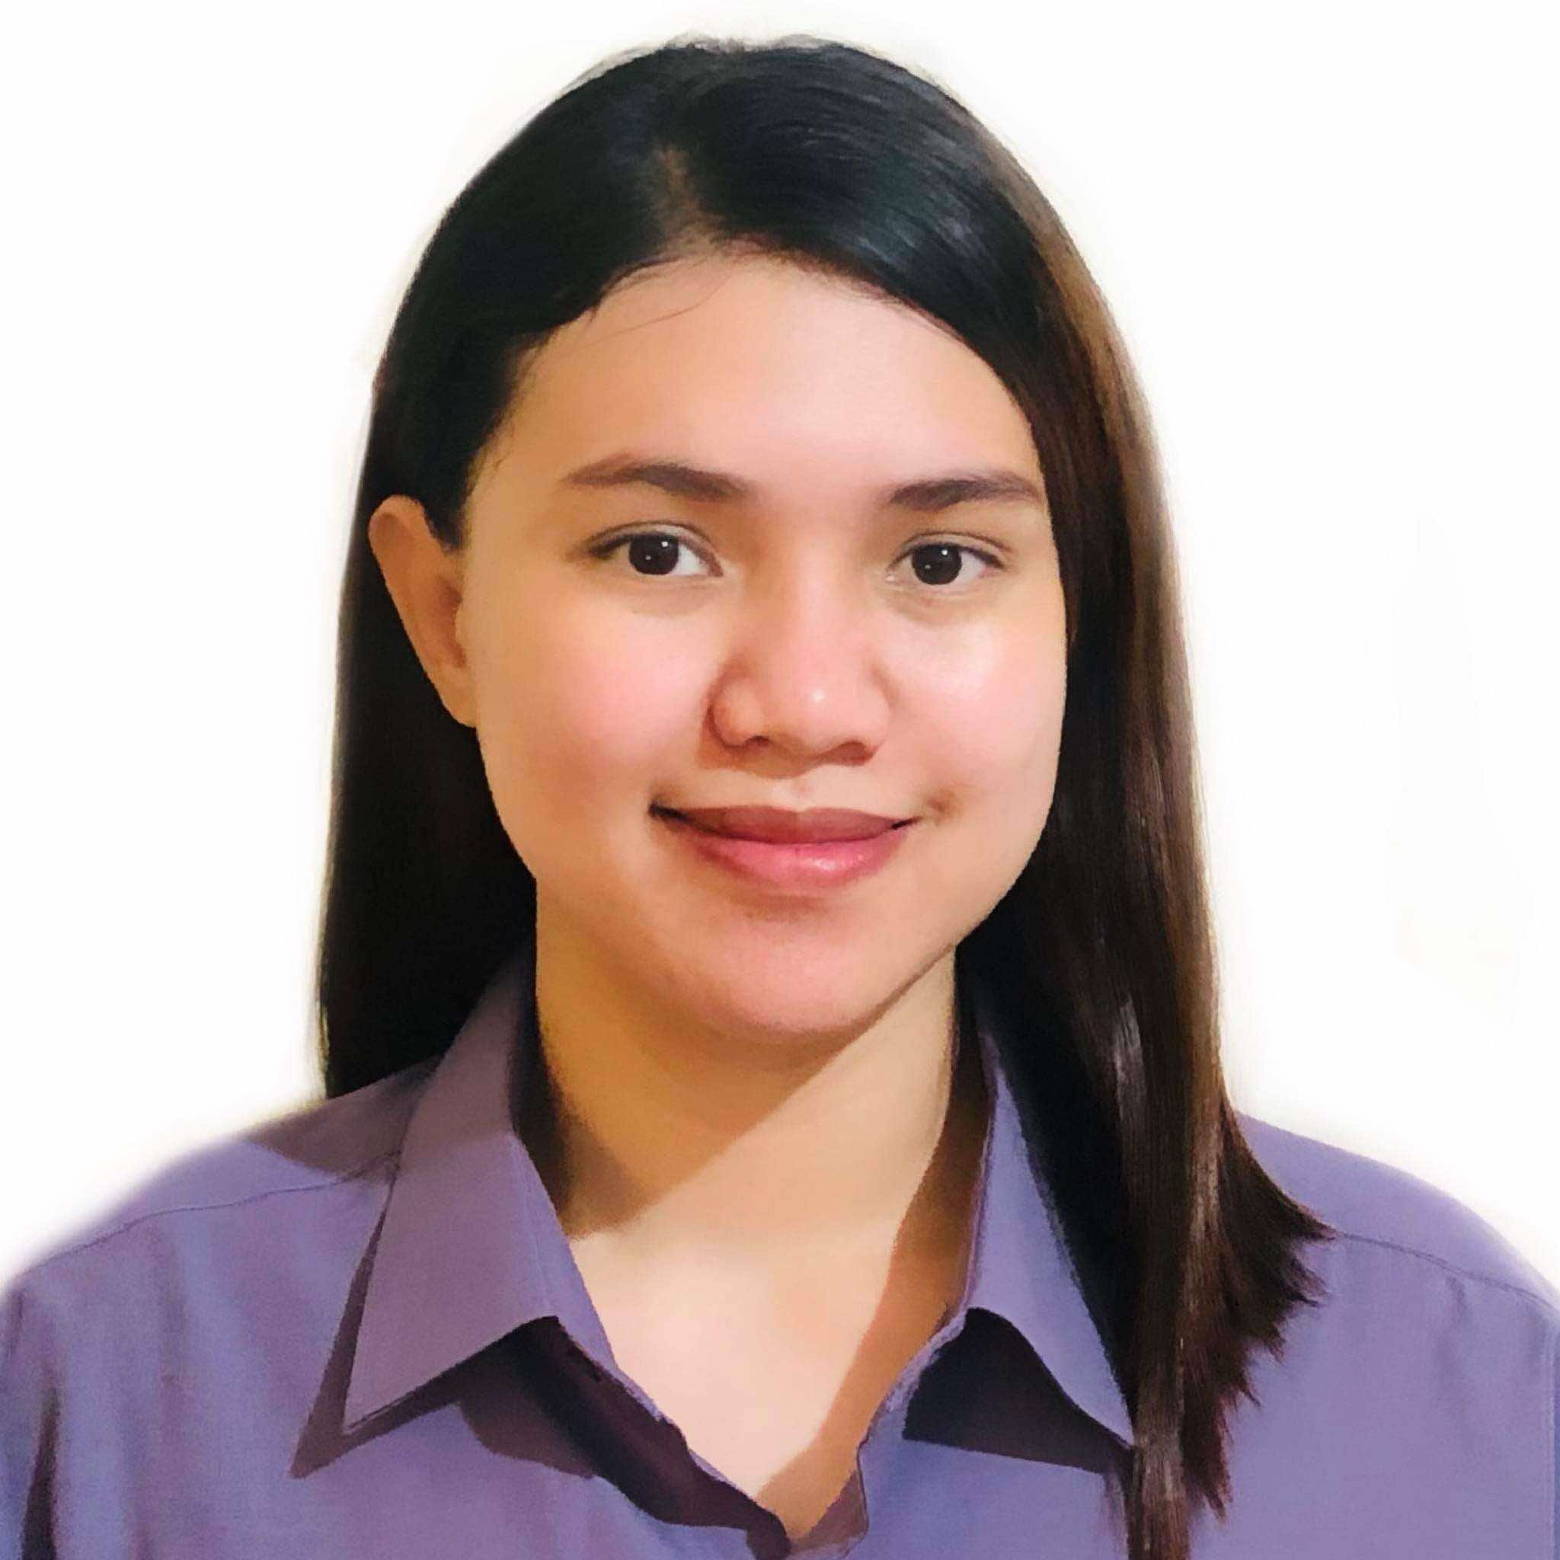
ABOUT ME
PORTFOLIO
CONTACT
I’m Wendy, a mother of three, and I’m currently in my third year of college, studying for a Bachelor of Science degree in Information Technology. I have over 7 years of experience as a Registrar Staff member in a college setting. I bring together administrative expertise and technical skills. My experience in educational administration has honed my abilities in data management, report creation, and student services. My ongoing IT education keeps me updated with the latest technologies and best practices.
I’m a reliable, consistent, and hard-working individual, seeking an opportunity to prove myself. I am confident that I can excel in the job I am applying for.
WENDY FRANCISCO
General Virtual Assistant

Slide 2
ABOUT ME
PORTFOLIO
CONTACT
I’m Wendy, a mother of three, and I’m currently in my third year of college, studying for a Bachelor of Science degree in Information Technology. I have over 7 years of experience as a Registrar Staff member in a college setting.
I’m Wendy, a mother of three, and I’m currently in my third year of college, studying for a Bachelor of Science degree in Information Technology. I have over 7 years of experience as a Registrar Staff member in a college setting.
I’m Wendy, a mother of three, and I’m currently in my third year of college, studying for a Bachelor of Science degree in Information Technology. I have over 7 years of experience as a Registrar Staff member in a college setting.

Slide 3




Slide 4

ABOUT ME
PORTFOLIO
CONTACT
GMAIL
wendytm013@gmail.com
UPWORK
WENDY F.
picture
MOBILE
0935 487 9190

